Slide 1
Capstone Project
Project type : Olympic game Analysis

Slide 2
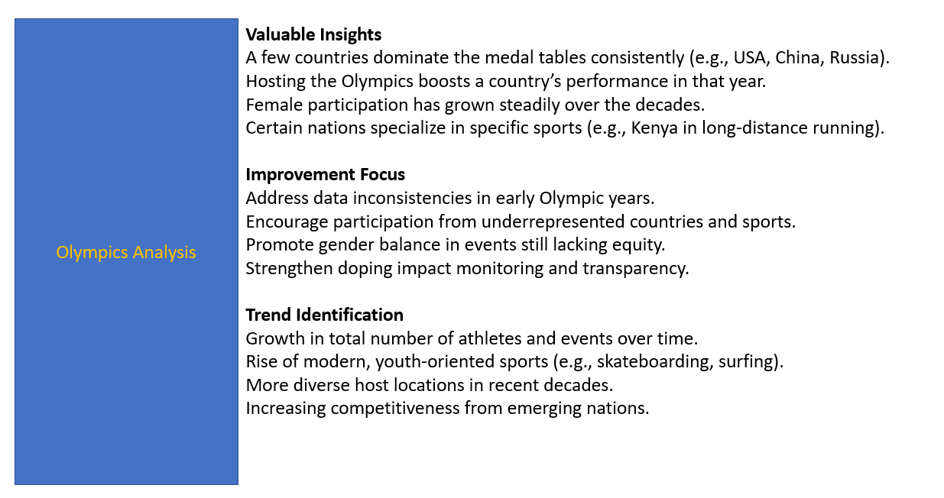
Introduction

Slide 3
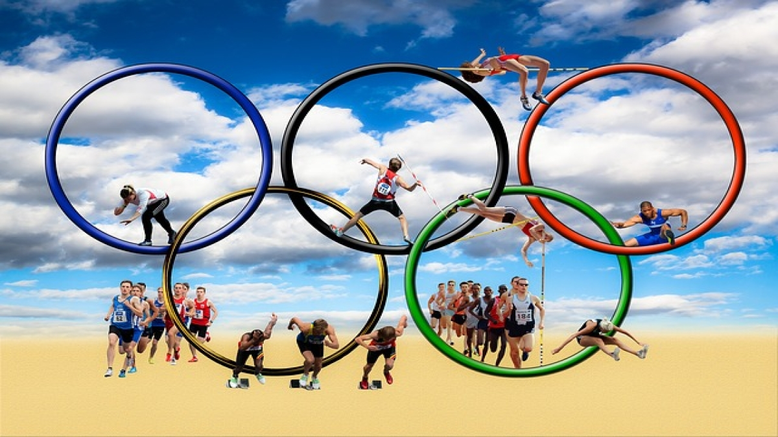
EDA Problem Statement

Slide 4
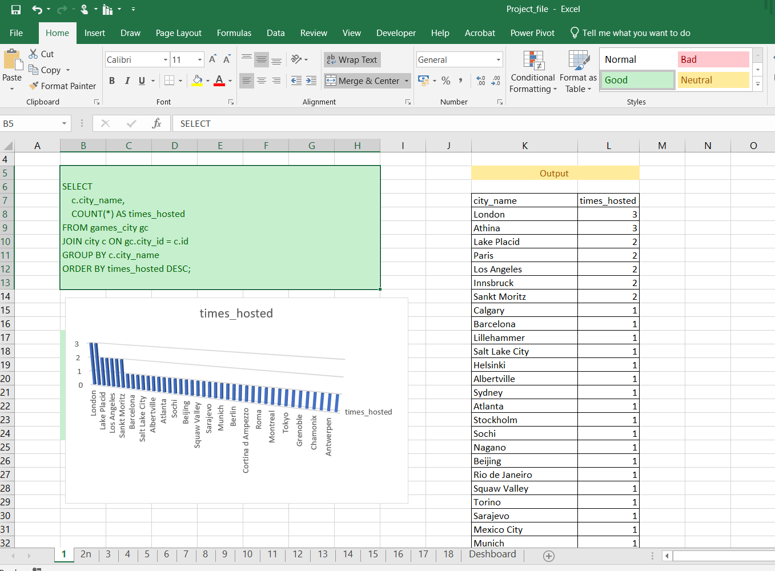
1
This Excel dashboard presents an analysis of how many times different cities have hosted the Olympic Games.

Slide 5
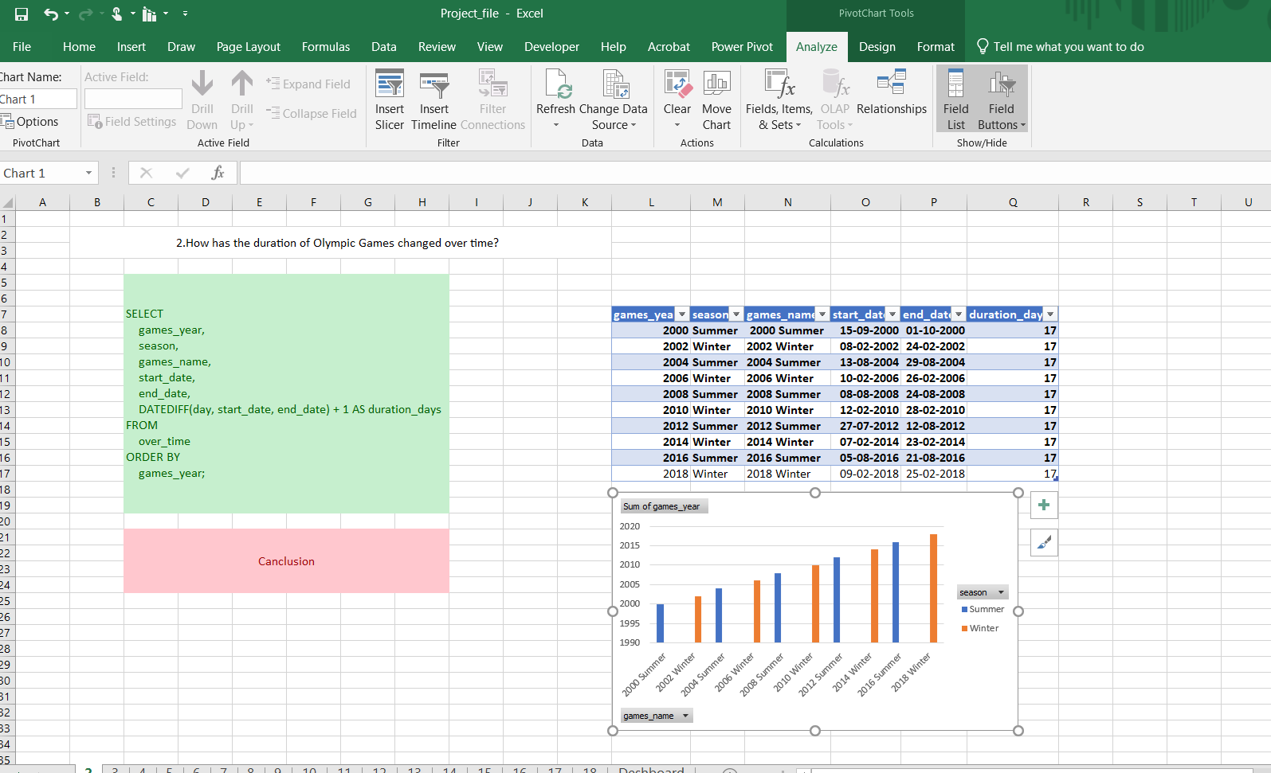
2
Insight: The duration of the Olympic Games has been consistent at 17 days from 2000 to 2018, with no variation over the years shown.

Slide 6
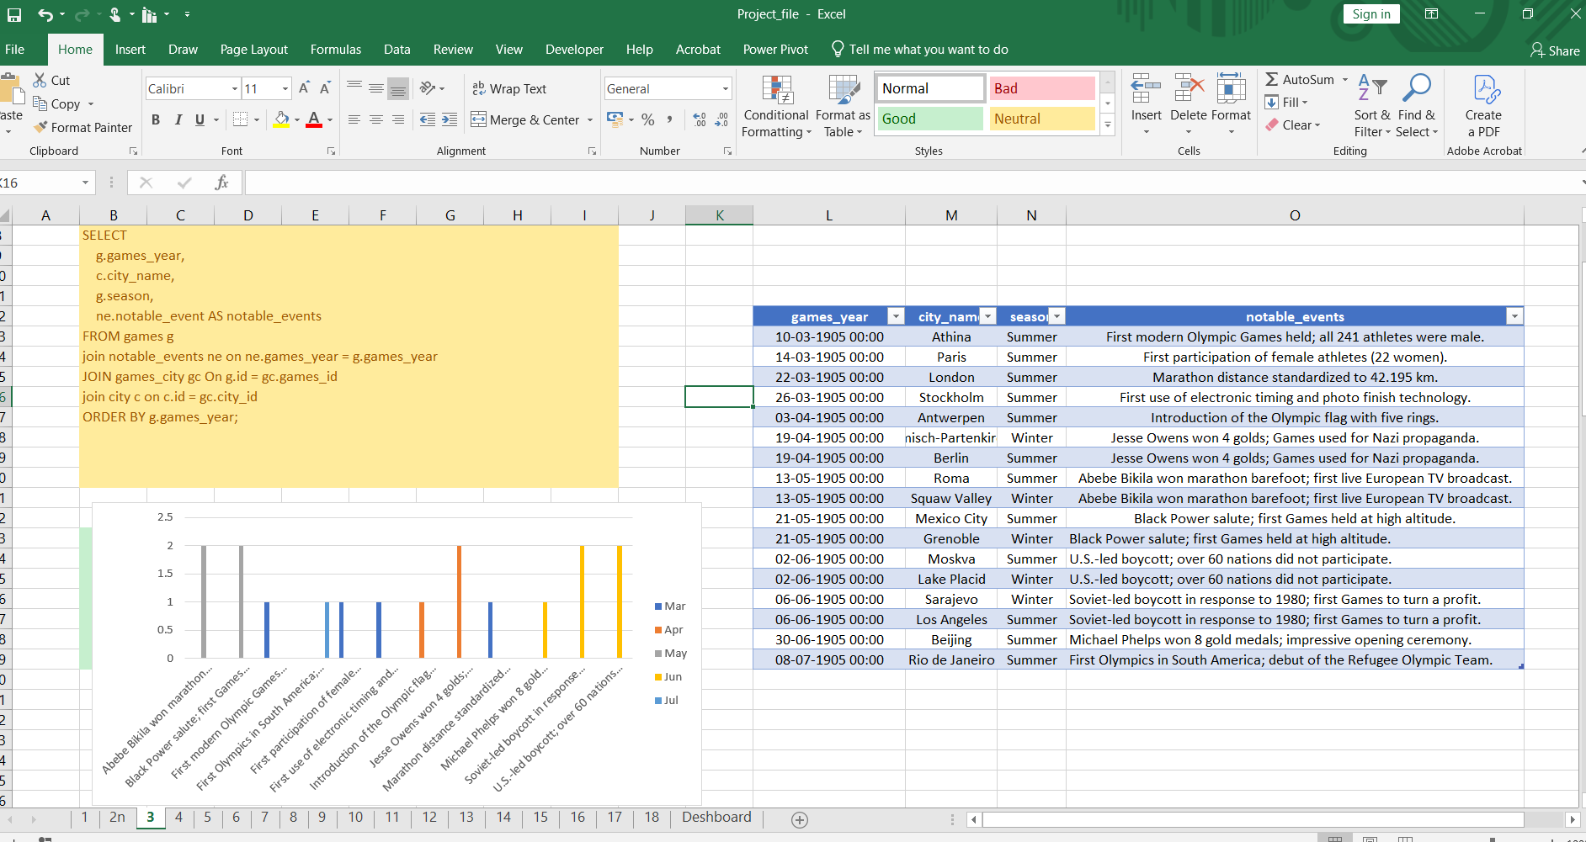
3
This slide appears to be part of a presentation, showcasing an analysis of the number of events in Olympic Games over time

Slide 7
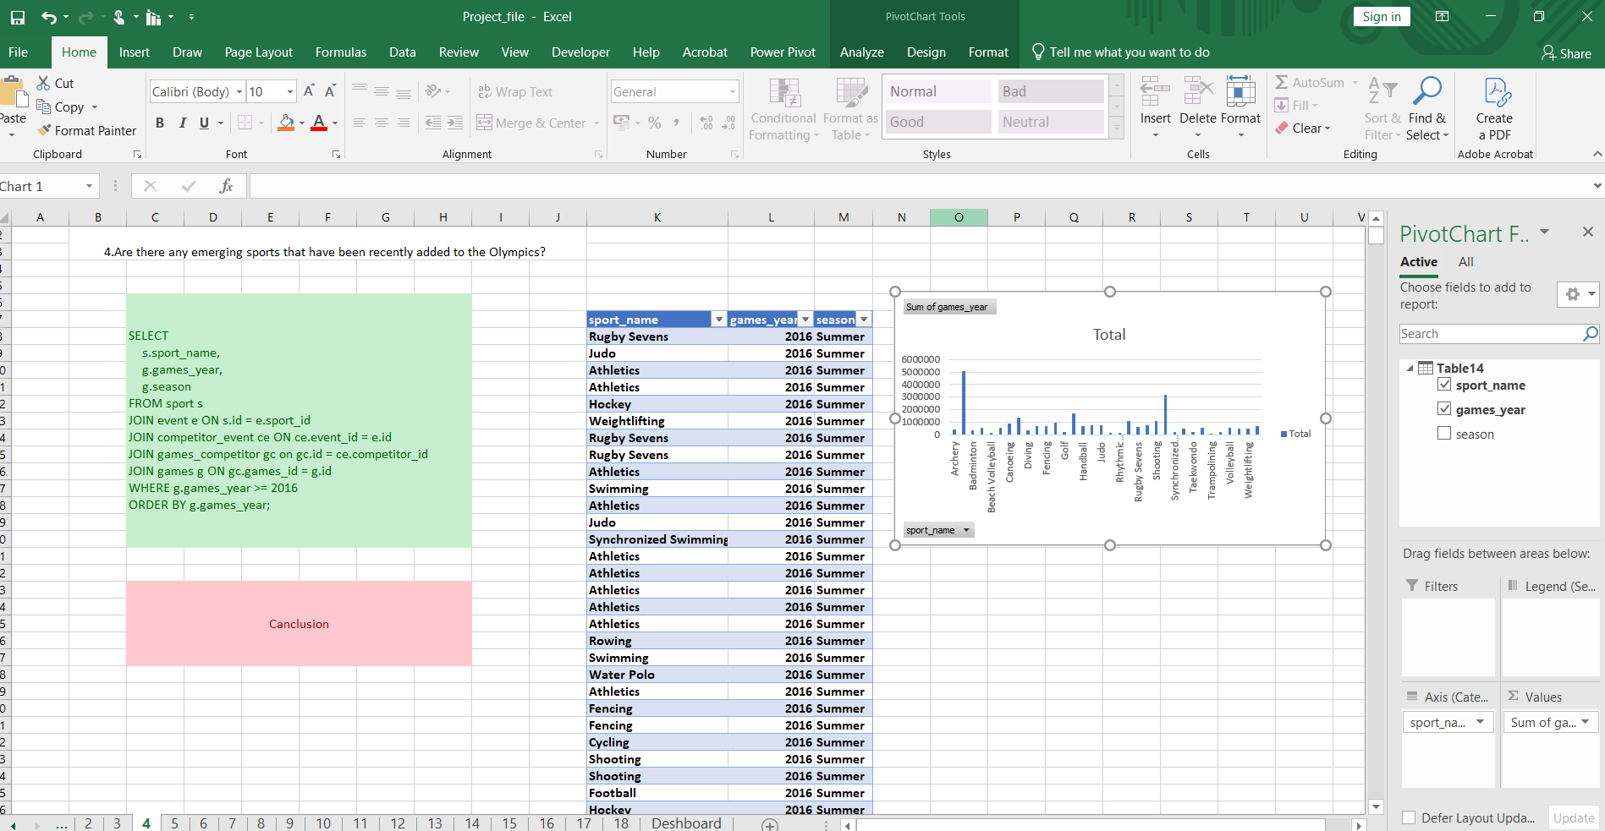
4
Rugby Sevens and Golf have emerged or returned to the Olympic program, reflecting evolving global interest and modernization of the Games. While traditional sports still dominate in participation

Slide 8
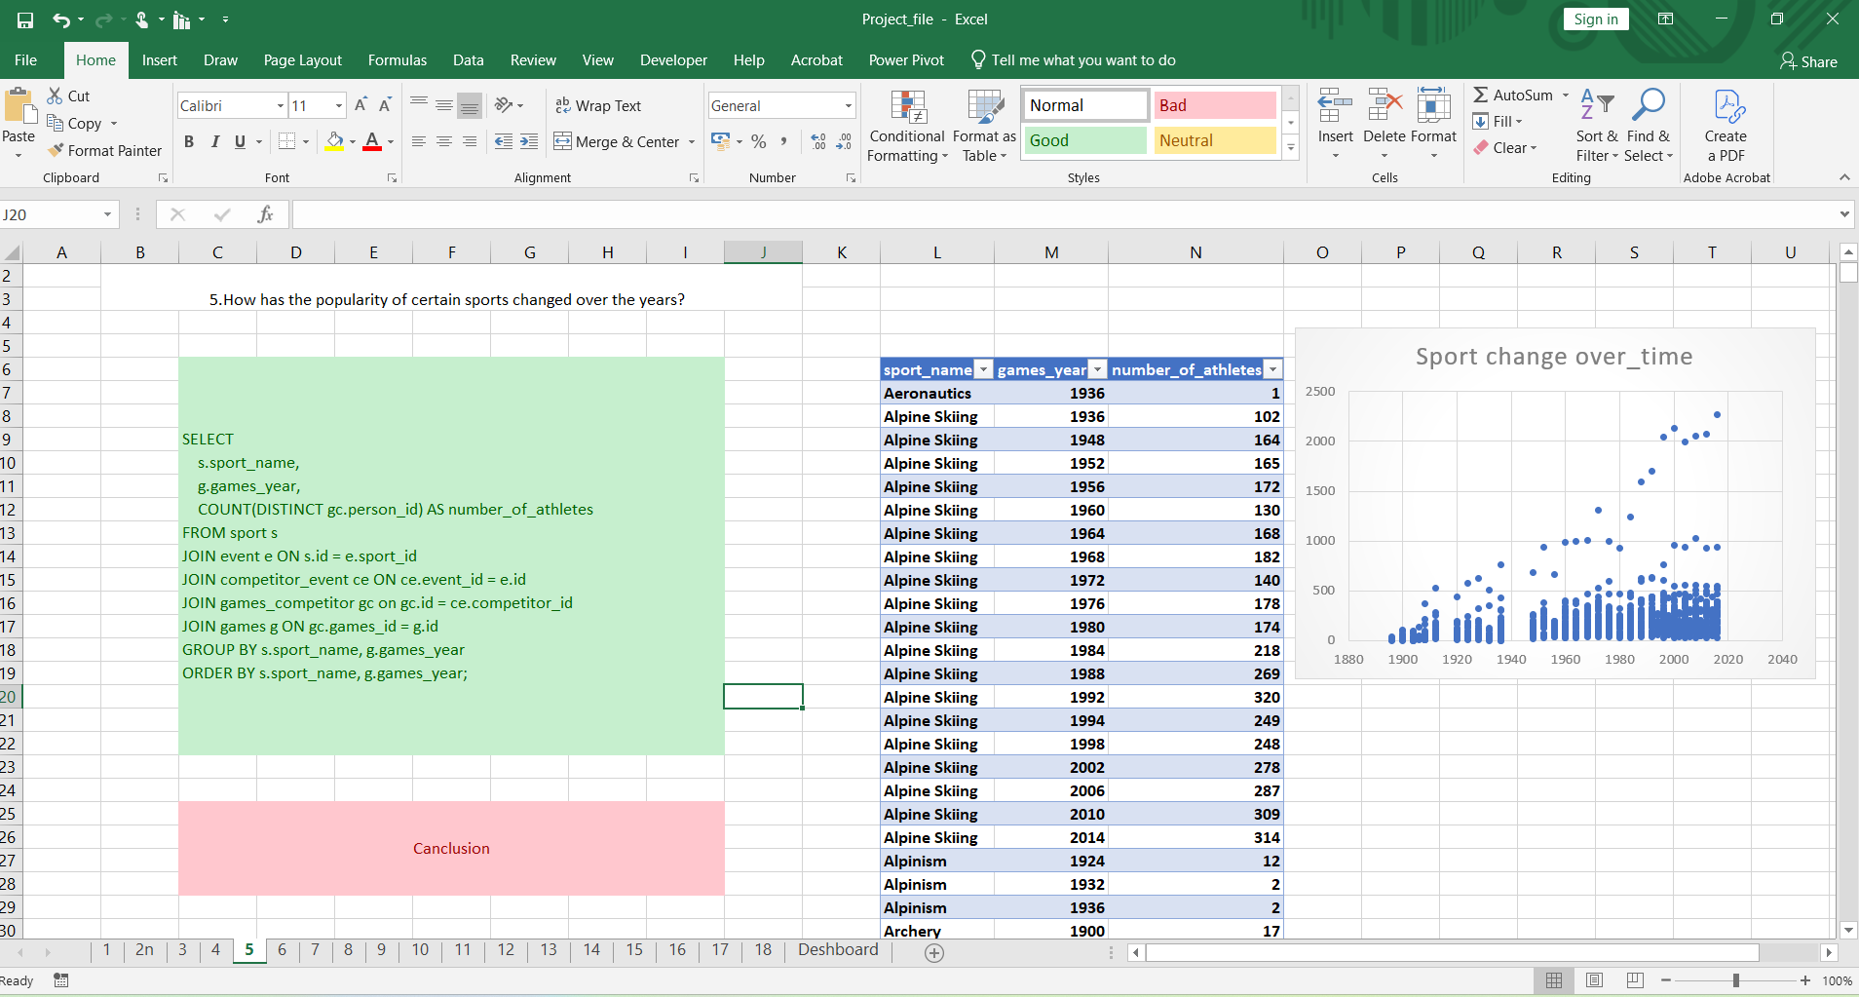
5
Shows the number of athletes for selected sports over different years. Example: Alpine Skiing shows gradual growth from 1936 to 2014.

Slide 9
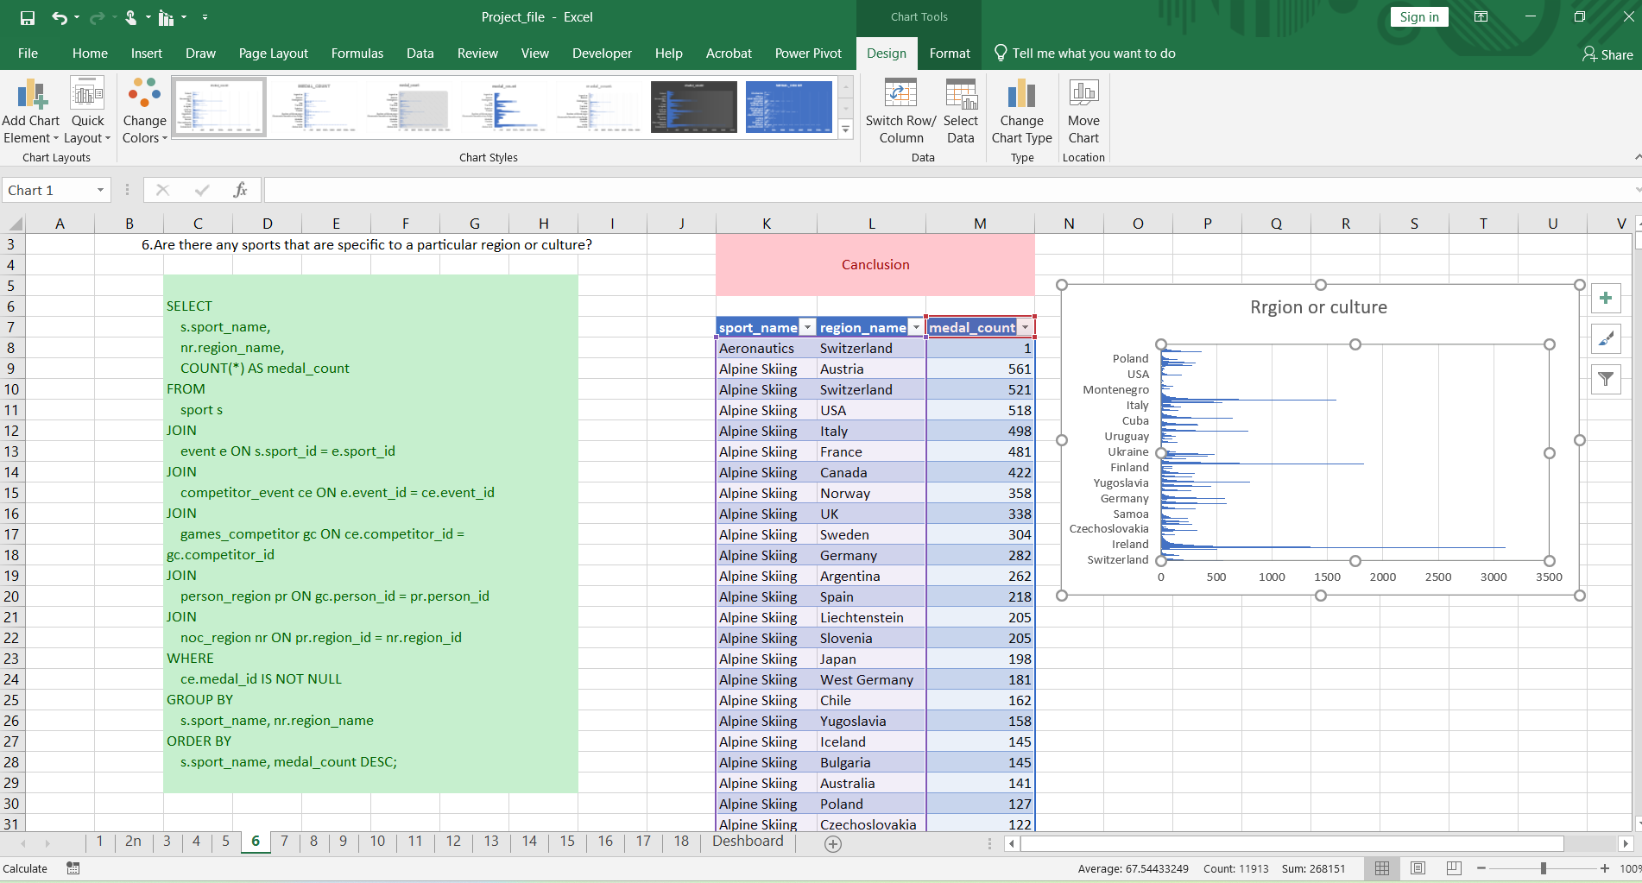
6
The query identifies which regions win the most medals in each sport, implying regional specialization:

Slide 10
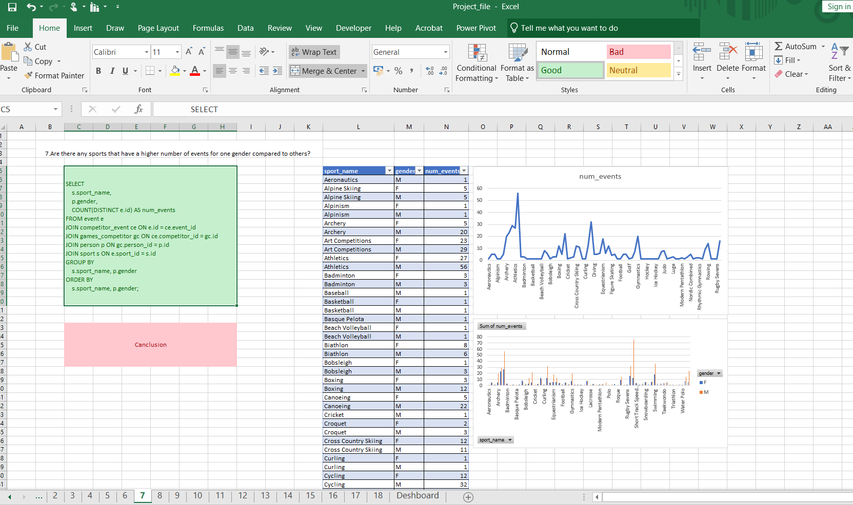
7
the number of distinct Olympic events for each sport and gender combination

Slide 11
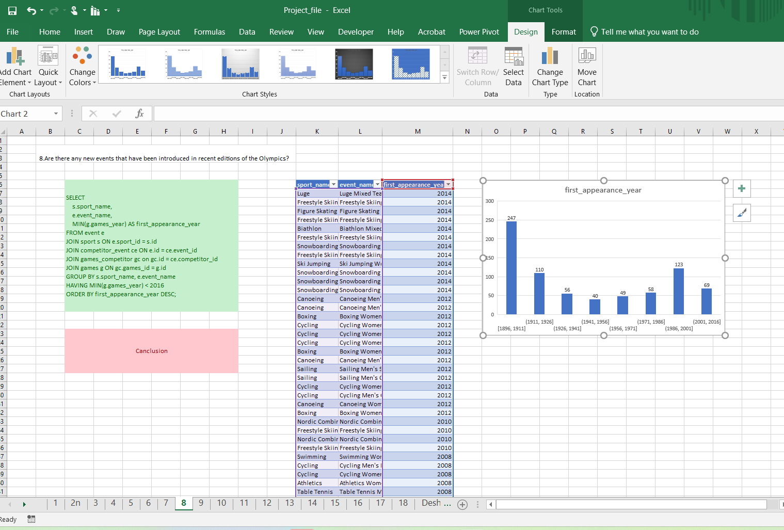
8
List each event's first appearance year in the Olympics, for events introduced before 2016.

Slide 12
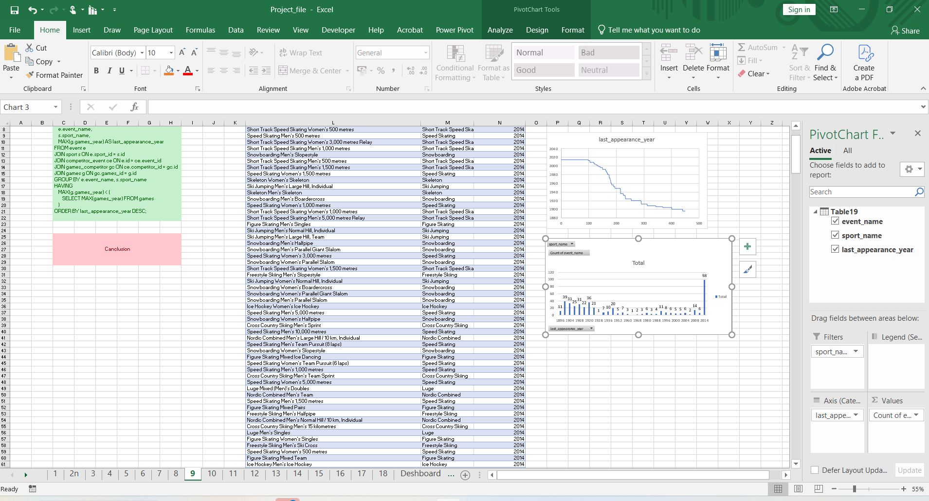
9
To list events that last appeared before the most recent Olympic year.

Slide 13
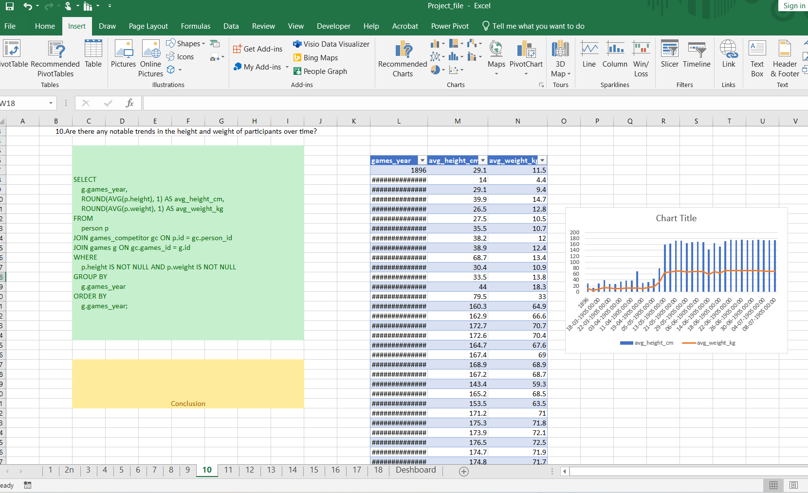
10
To analyze the average physical characteristics (height and weight) of athletes have changed over different Olympic Games years.

Slide 14
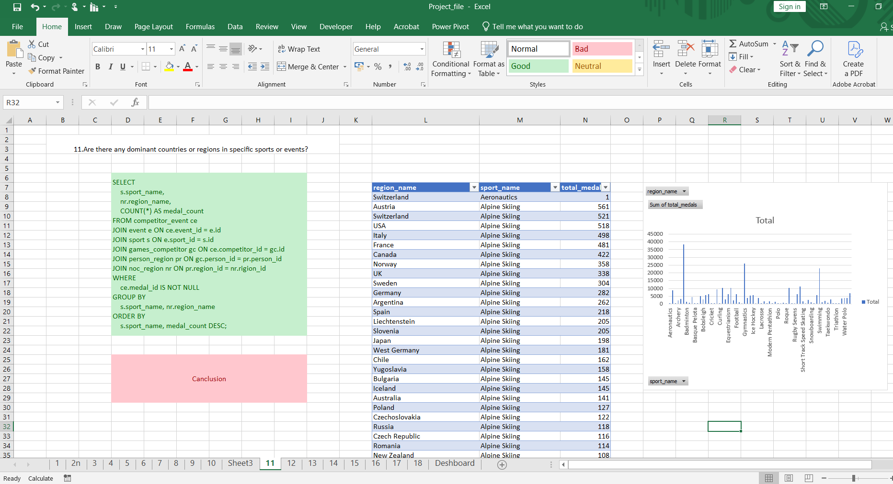
11
To find out the medals each region (country/area) has won in each sport across all Olympic Games.

Slide 15
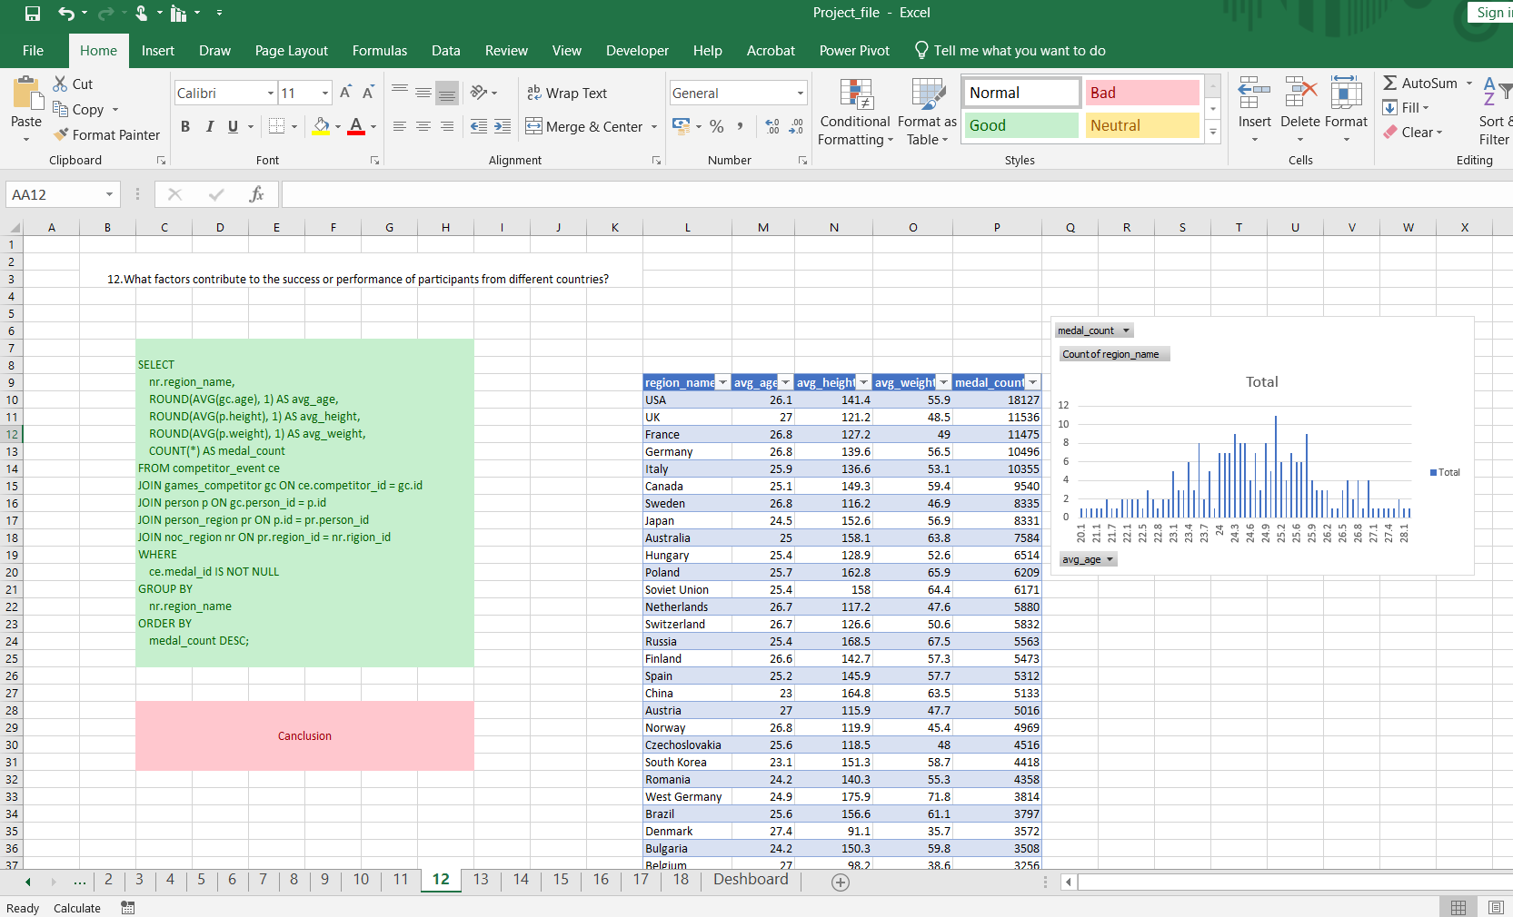
12
To find out the average age, height, and weight of athletes from each region who have won medals, along with the total medal count for each region.

Slide 16
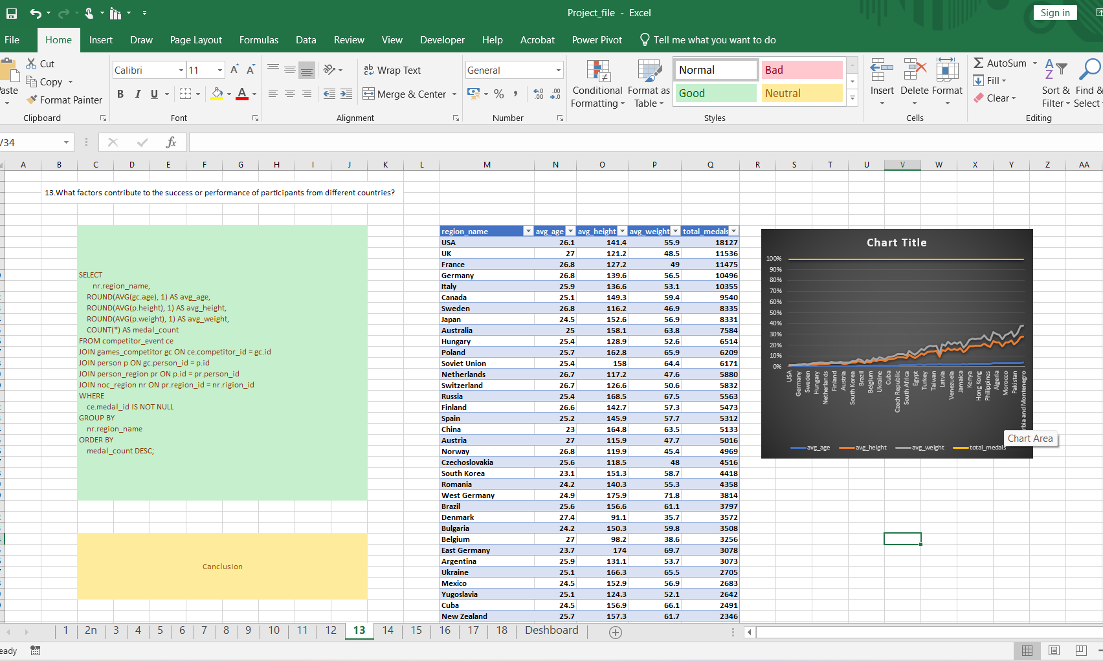
13
the average age, height, and weight of athletes from each region who have won medals, along with the total medal count for each region.

Slide 17
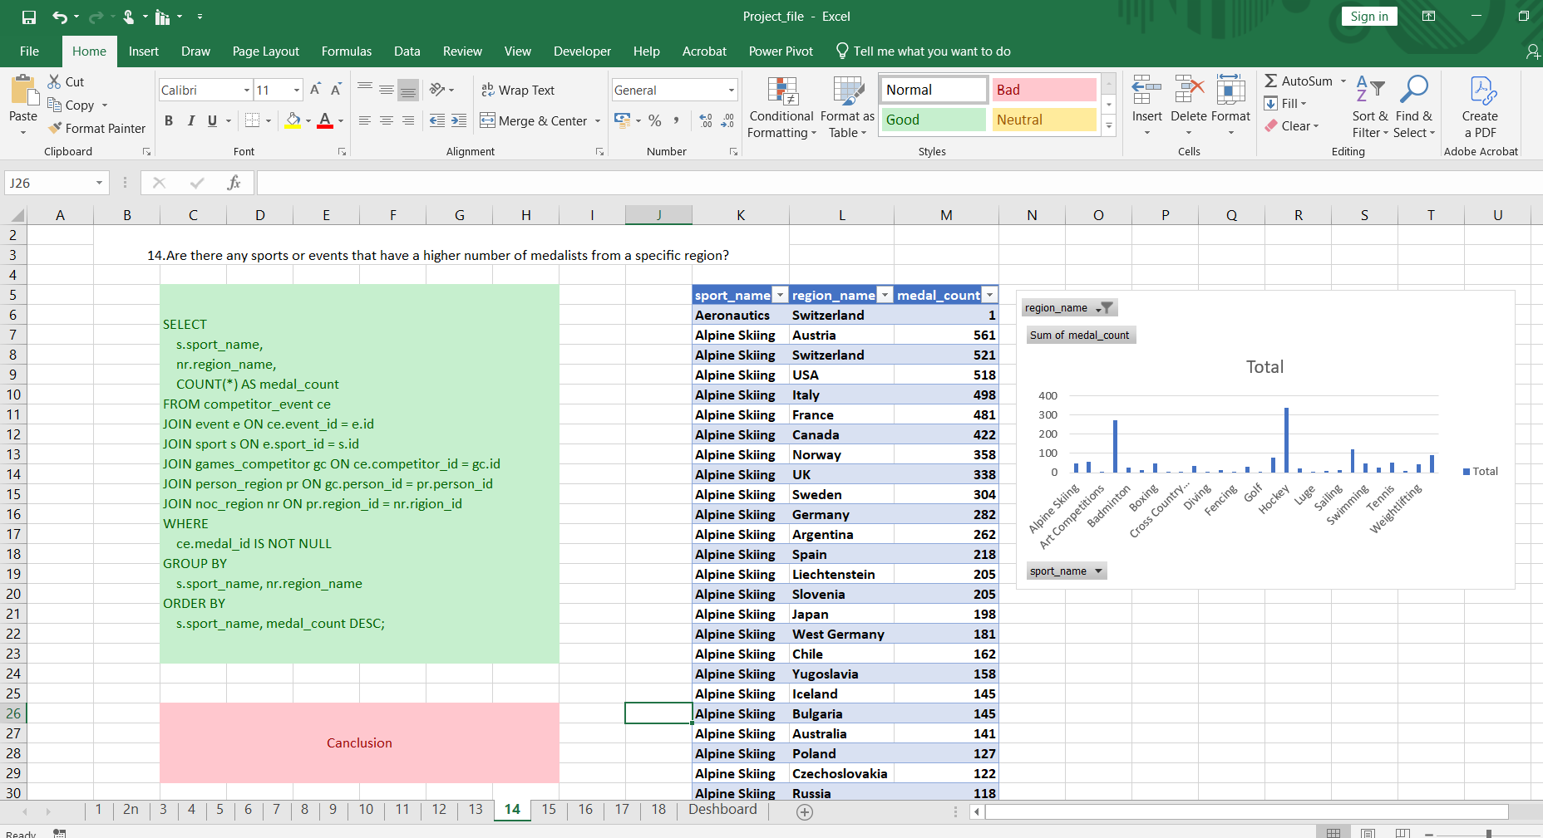
14
To analyze medal distribution by sport and region across all Olympic Games.

Slide 18
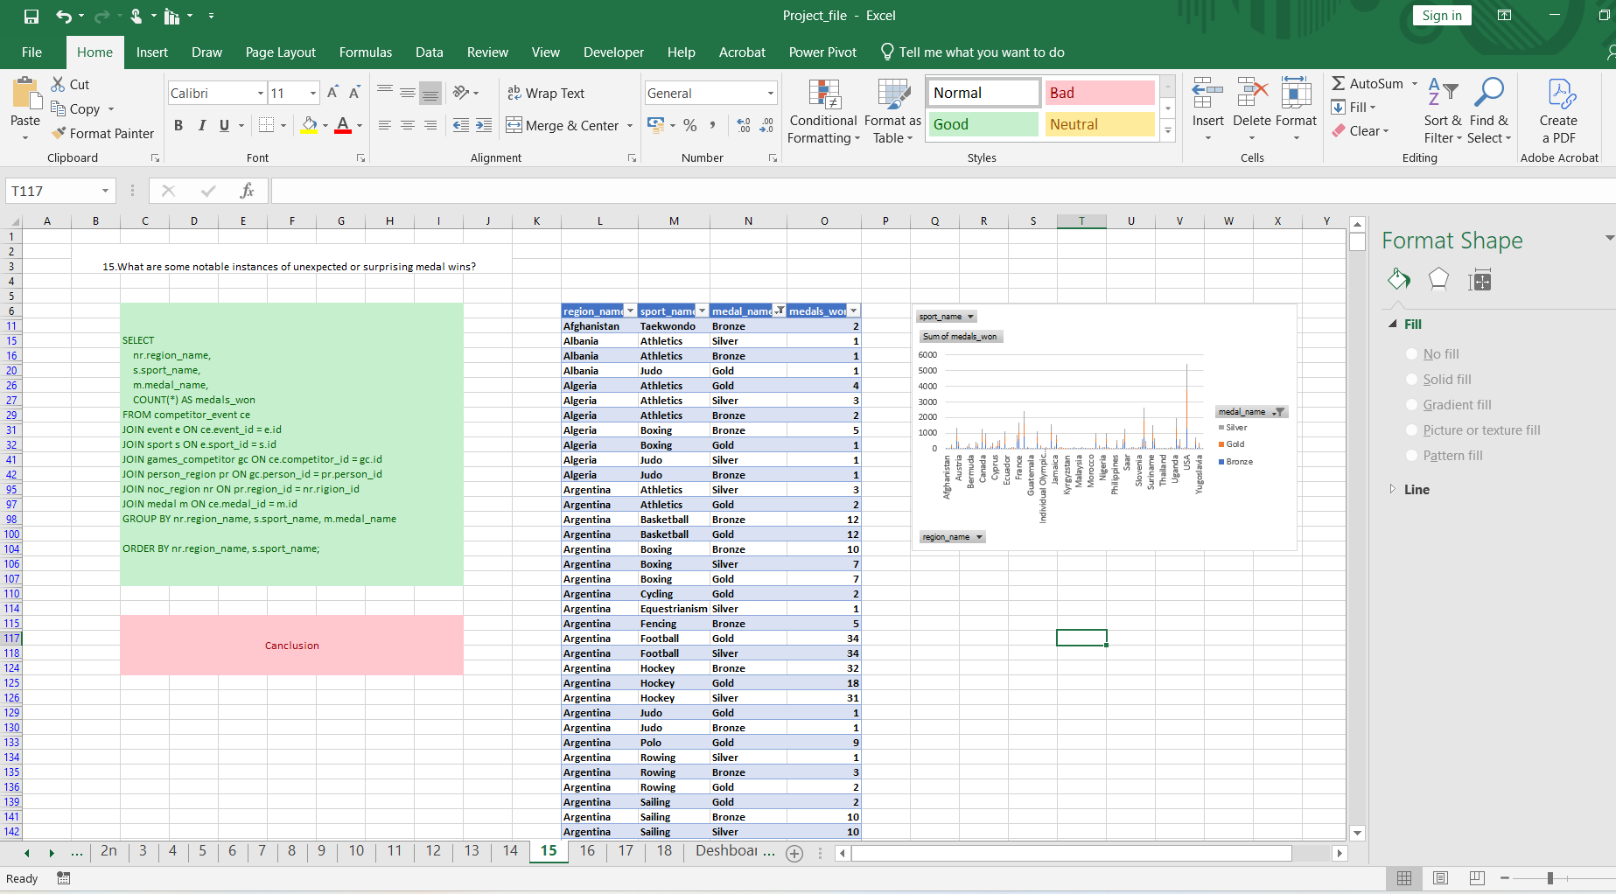
15
Gold, Silver, and Bronze medals each region has won in each sport

Slide 19
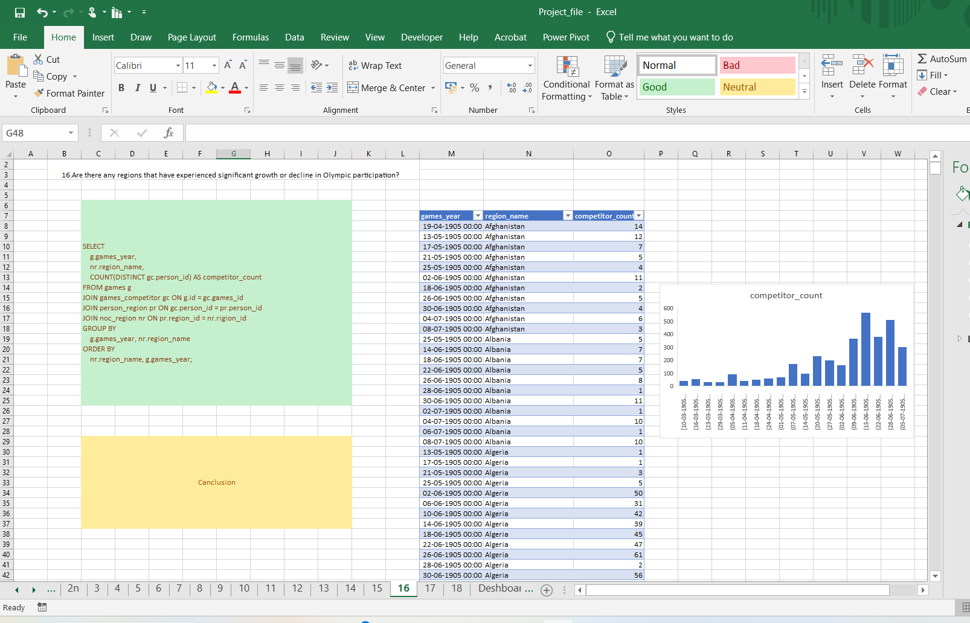
16
the number of athletes representing each region across different Olympic years.

Slide 20
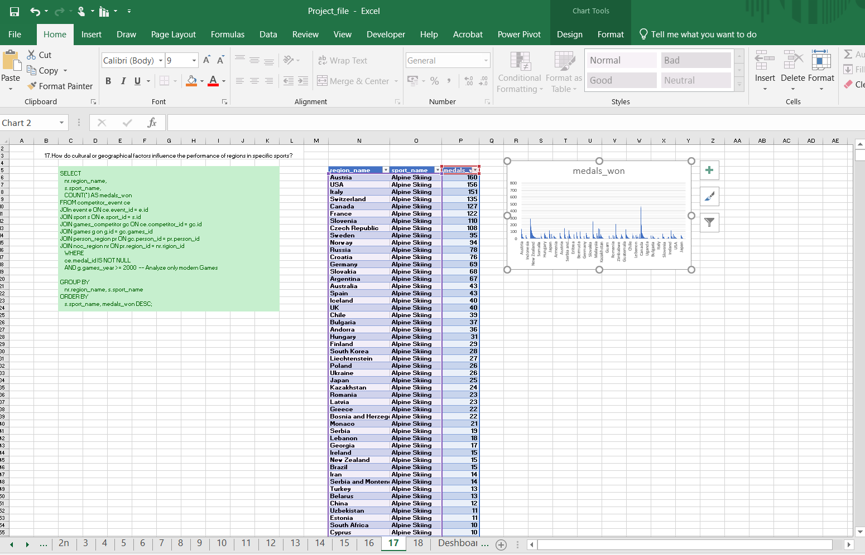
17
Different regions (countries/NOCs) have performed in terms of medals won in each sport since the year 2000.

Slide 21
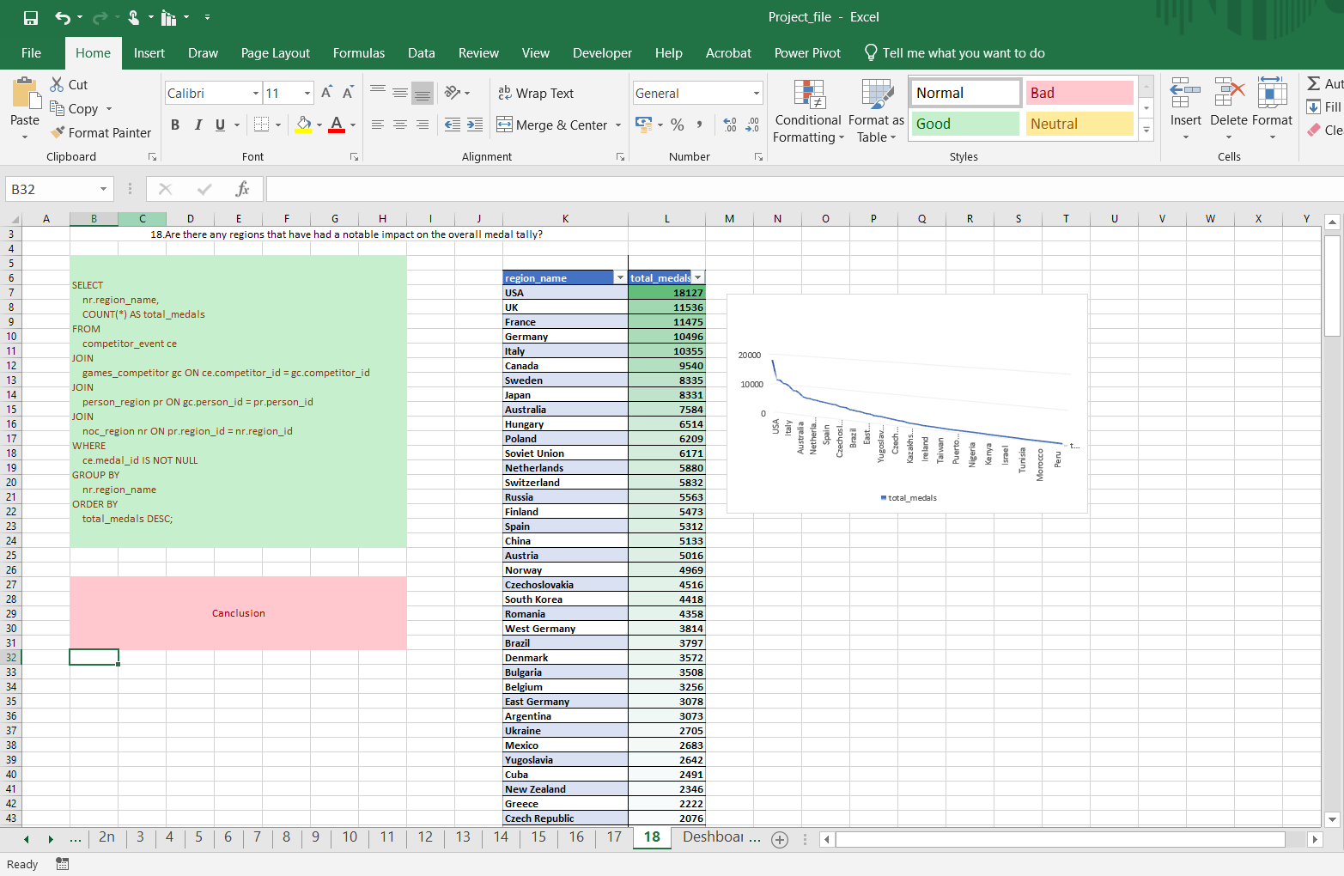
18
To determine the overall medal tally for each region across all Olympic Games.

Slide 22
Power Bi Problem Statment

Slide 23
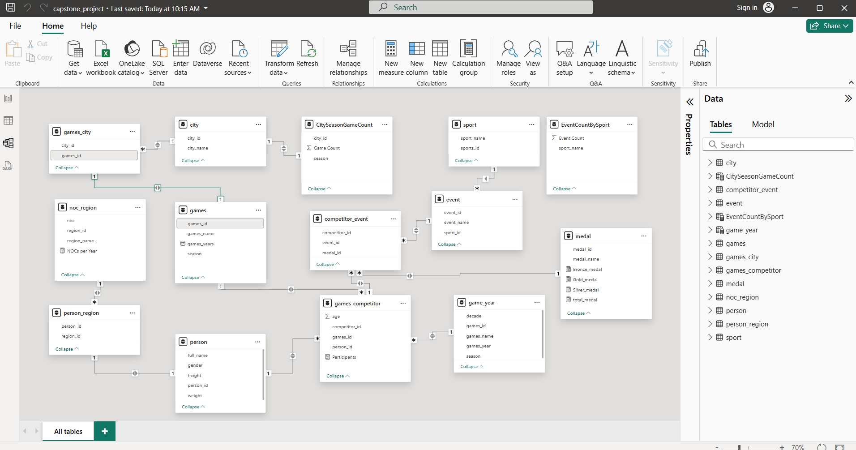
Power BI

Slide 24
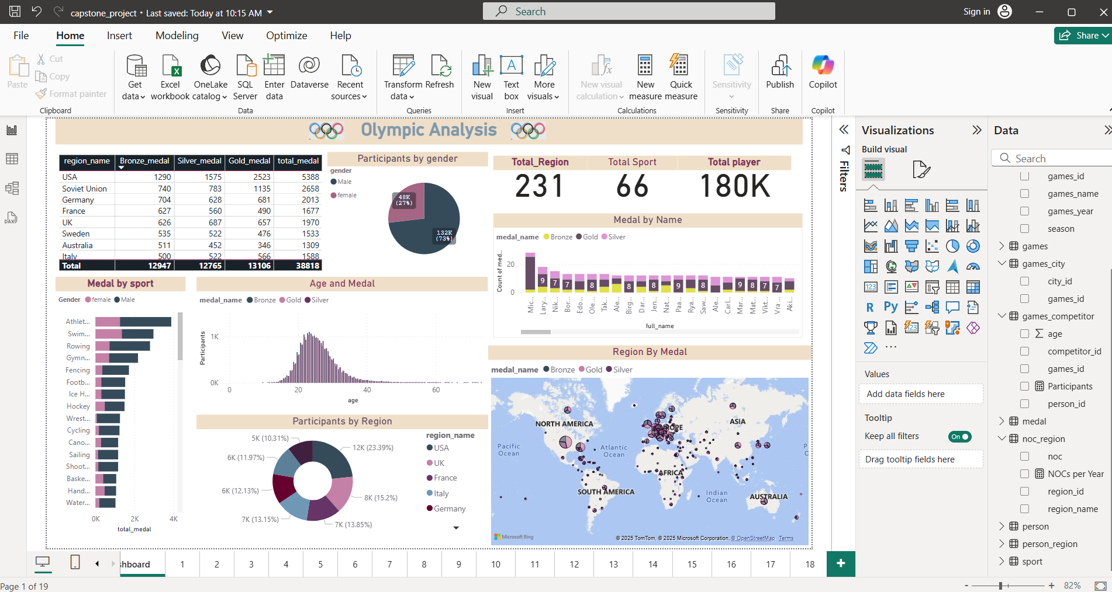
Dashboard

Slide 25
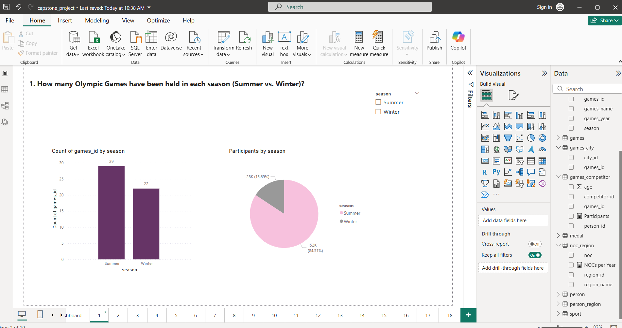
1

Slide 26
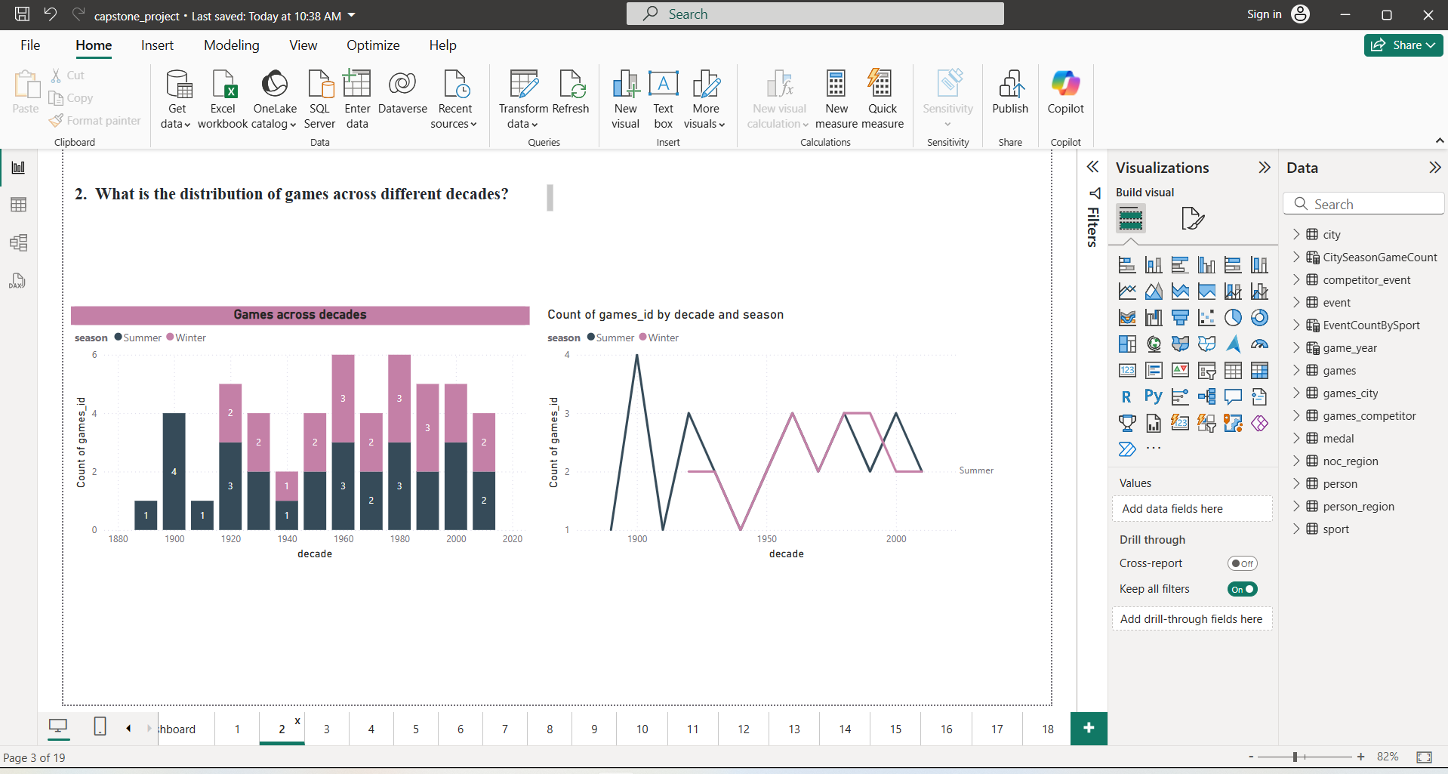
2

Slide 27
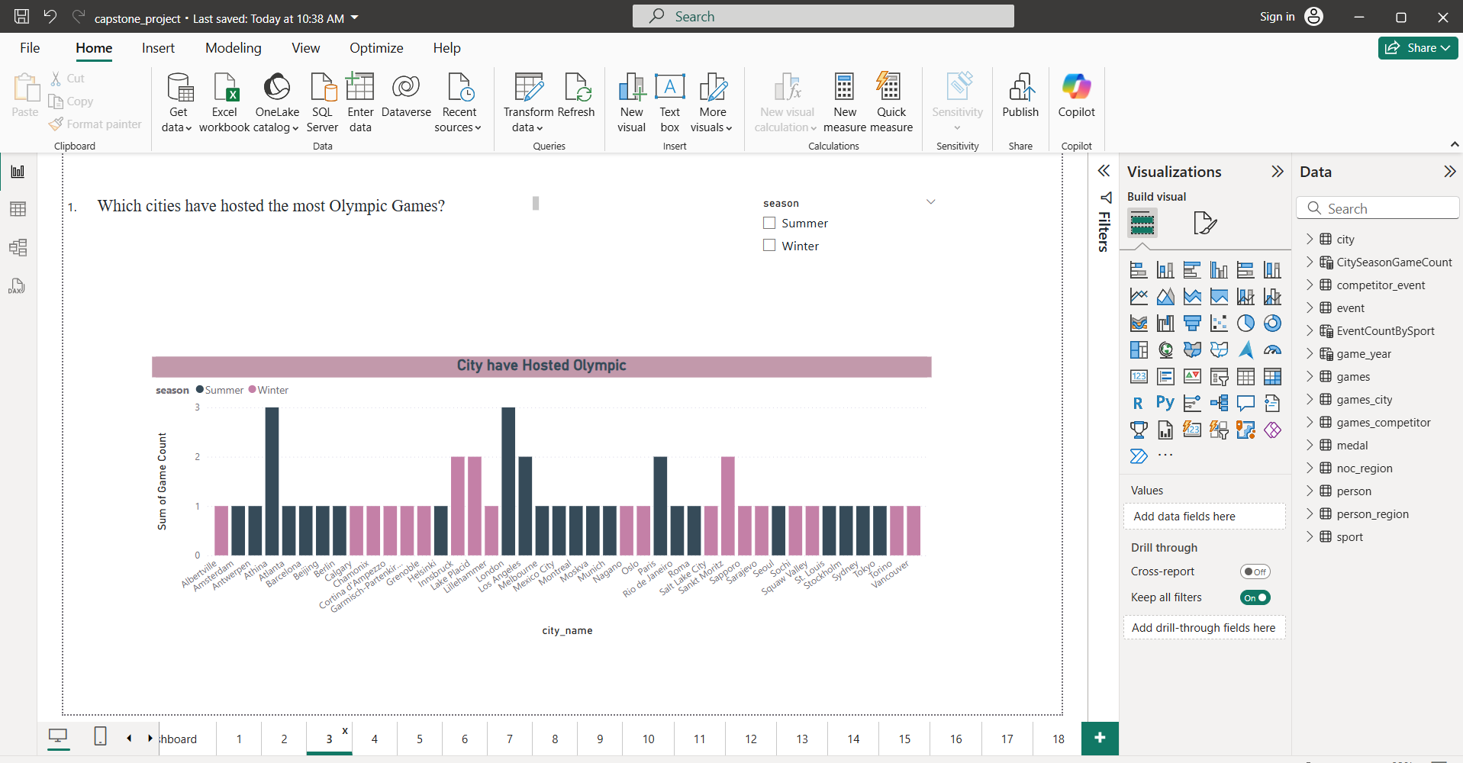
3

Slide 28
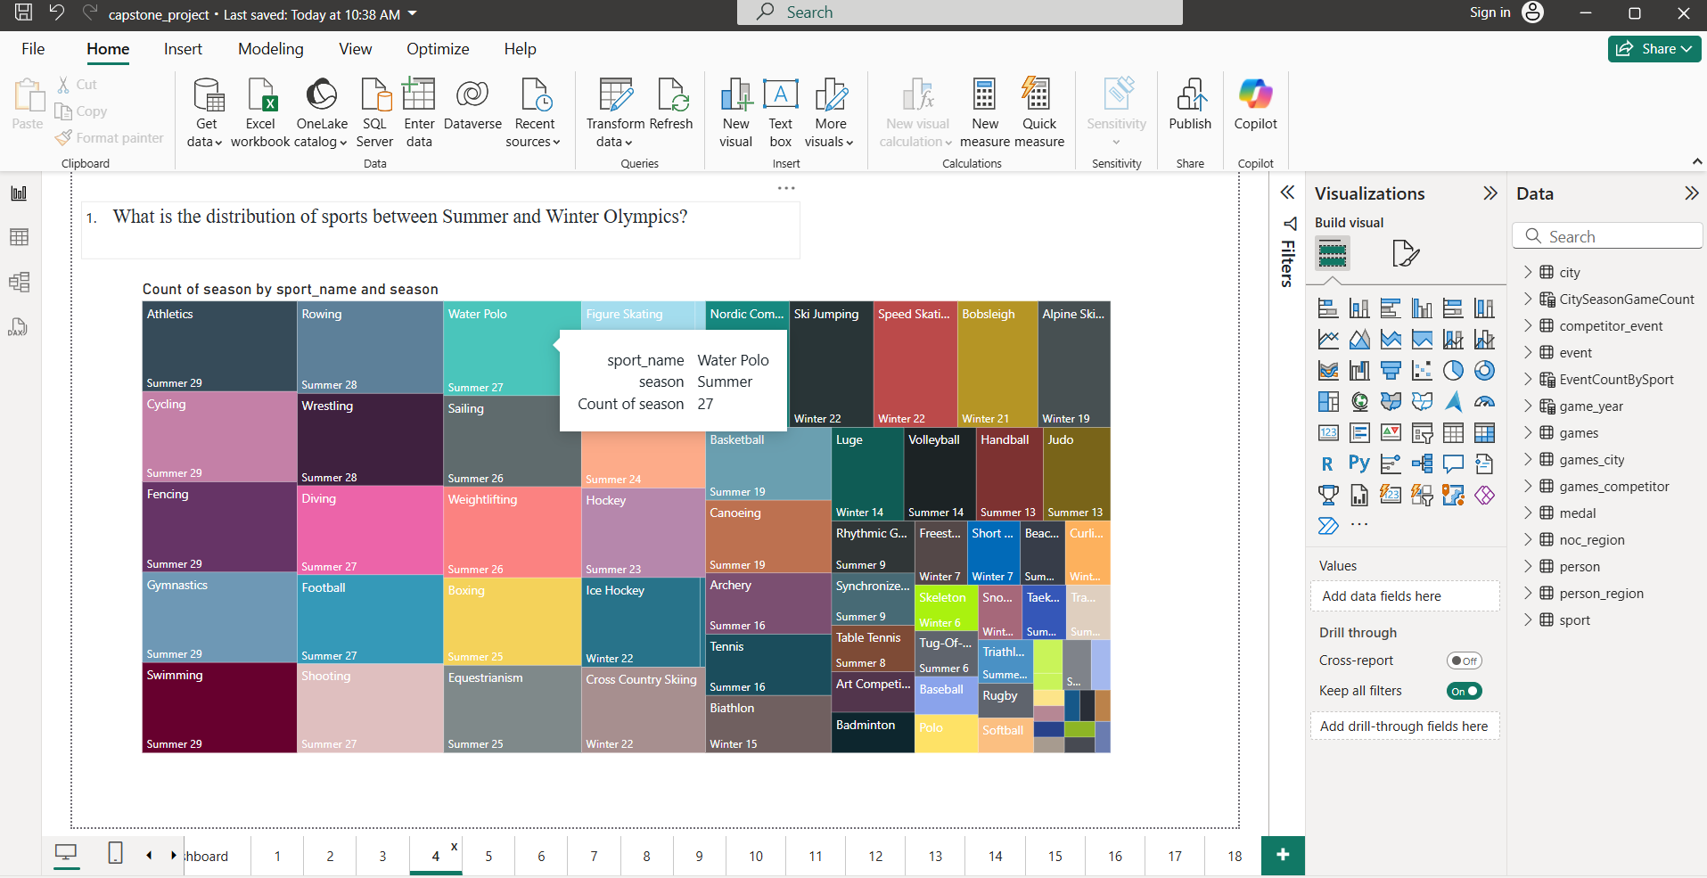
4

Slide 29
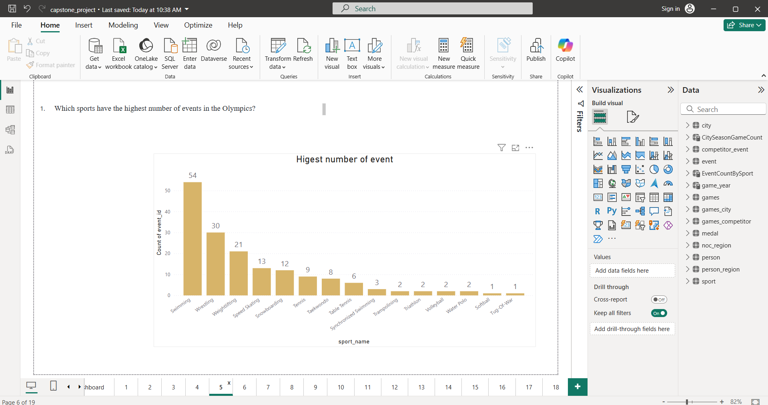
5

Slide 30
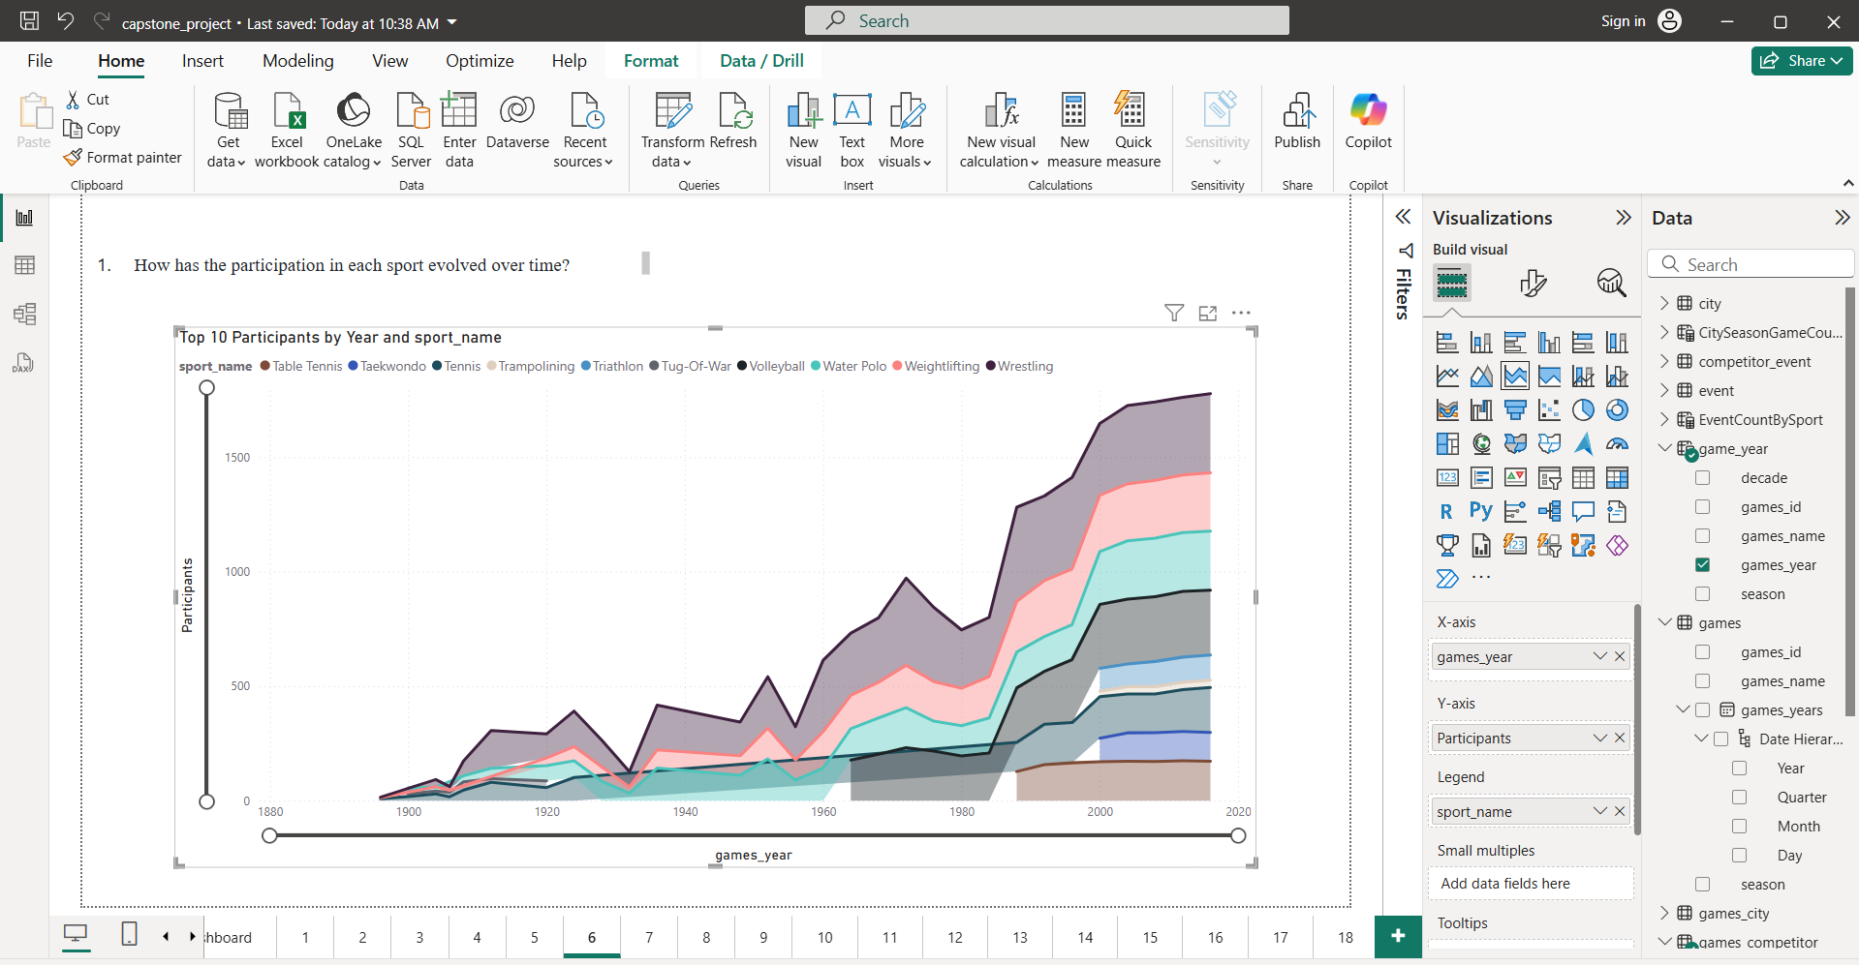
6

Slide 31
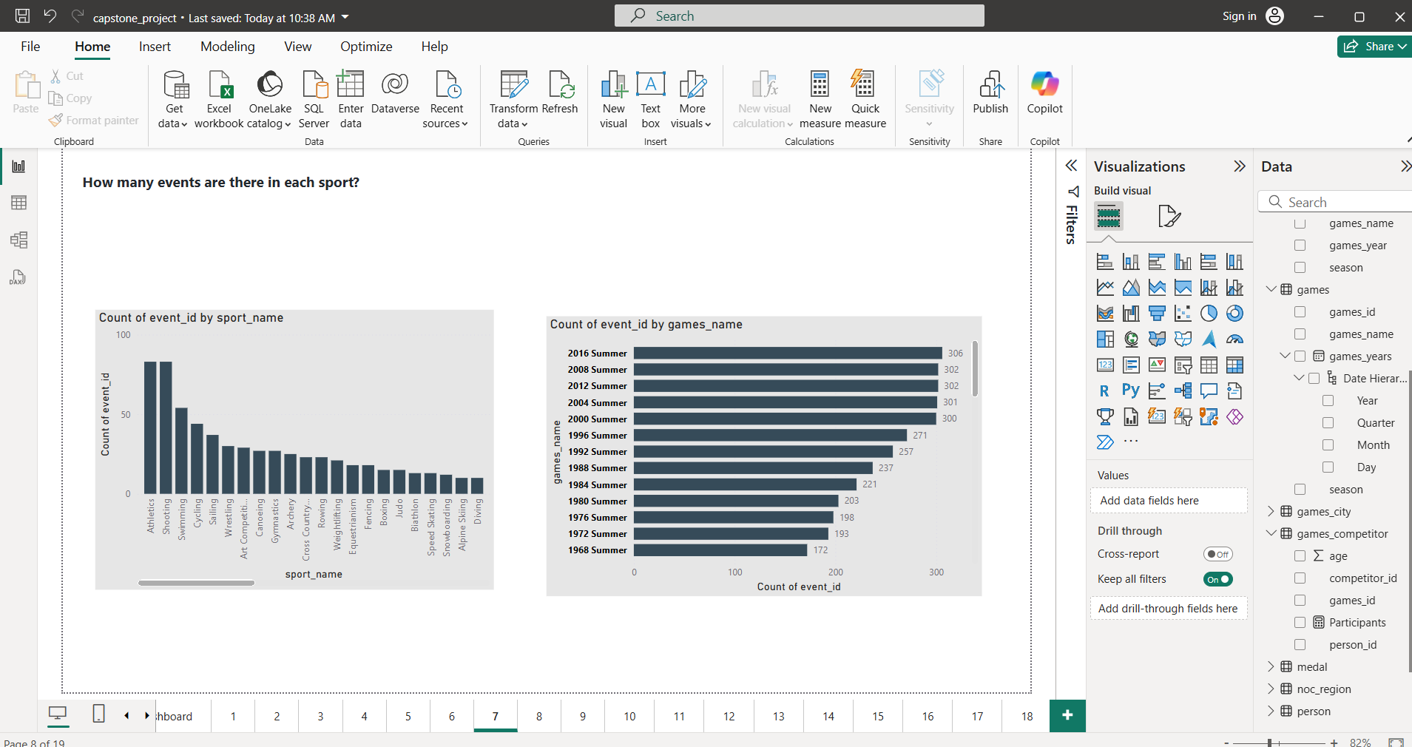
7

Slide 32
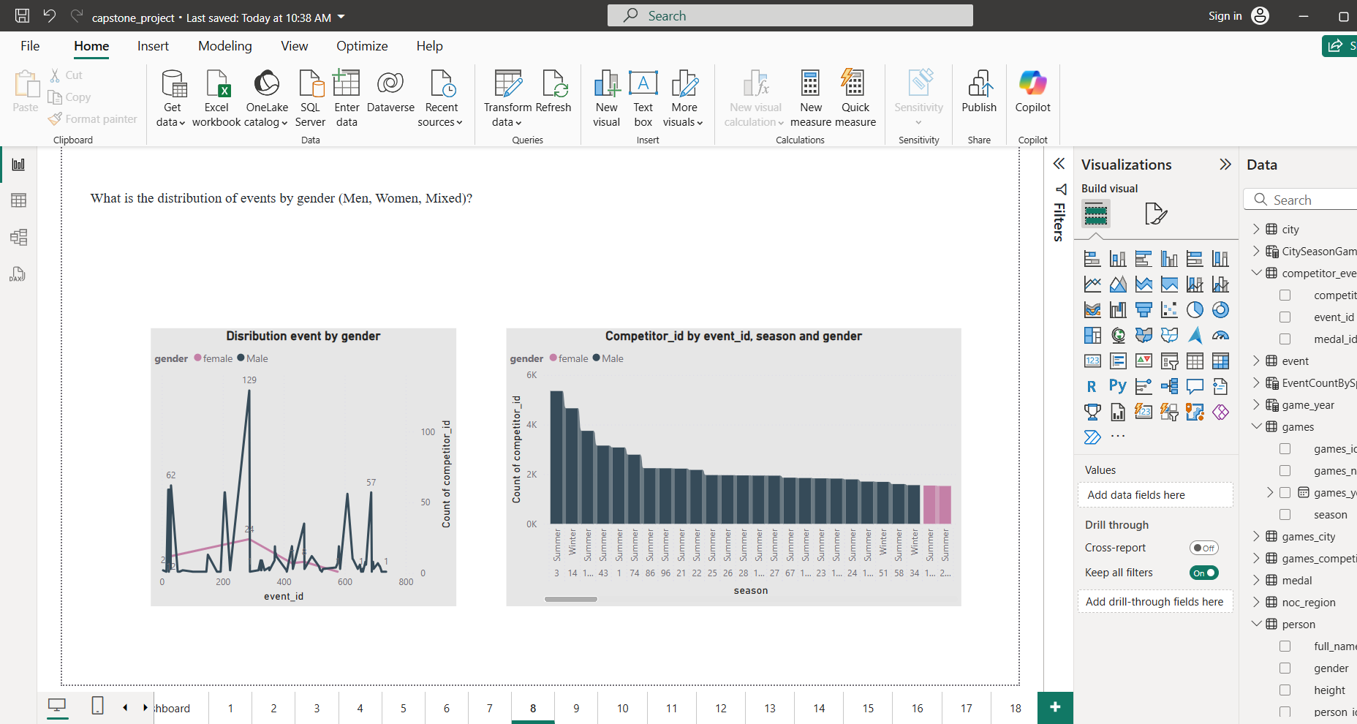
8

Slide 33
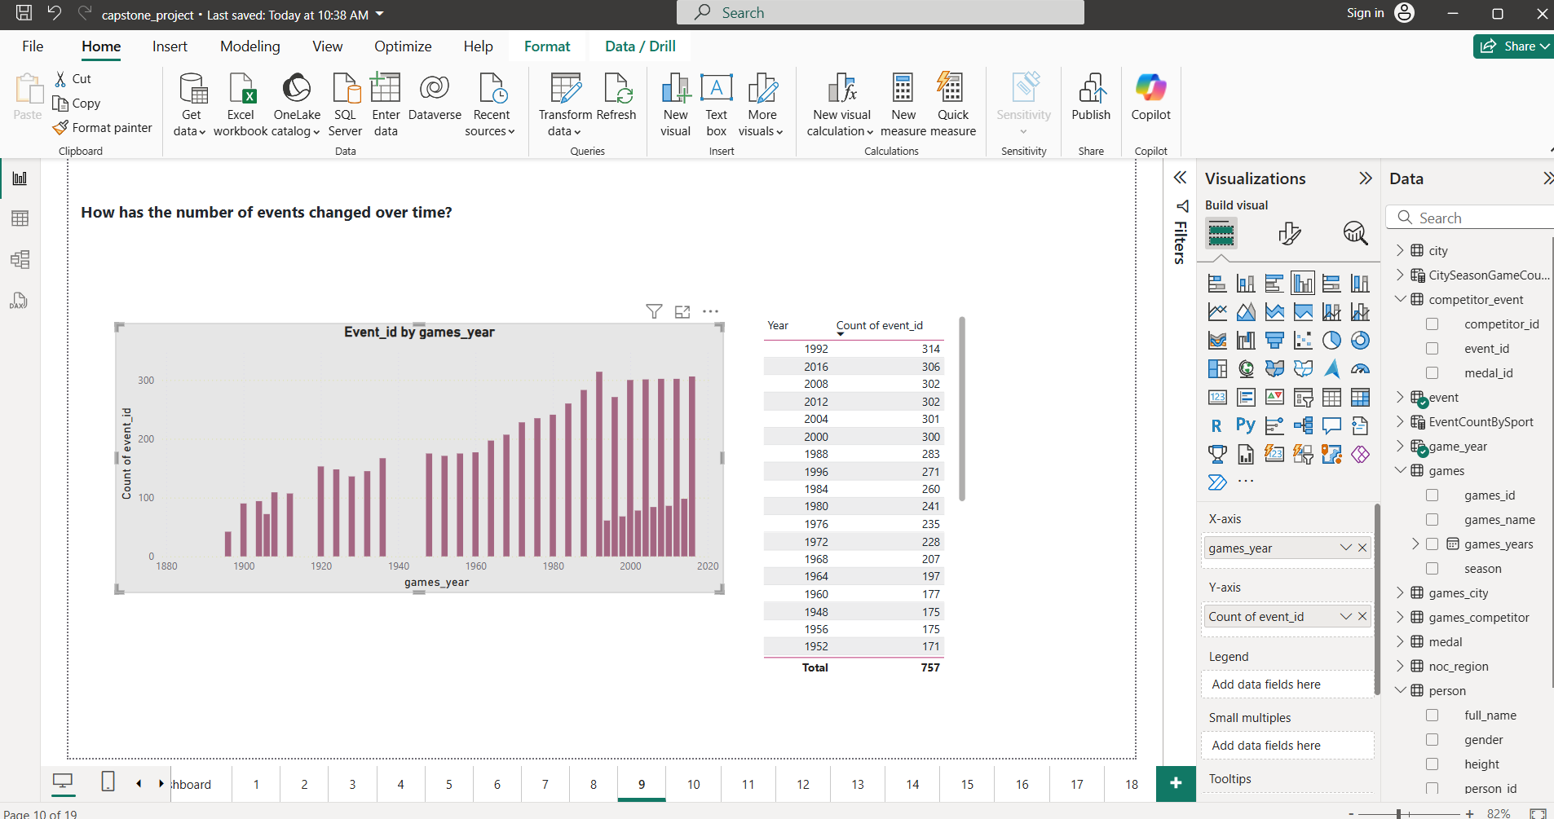
9

Slide 34
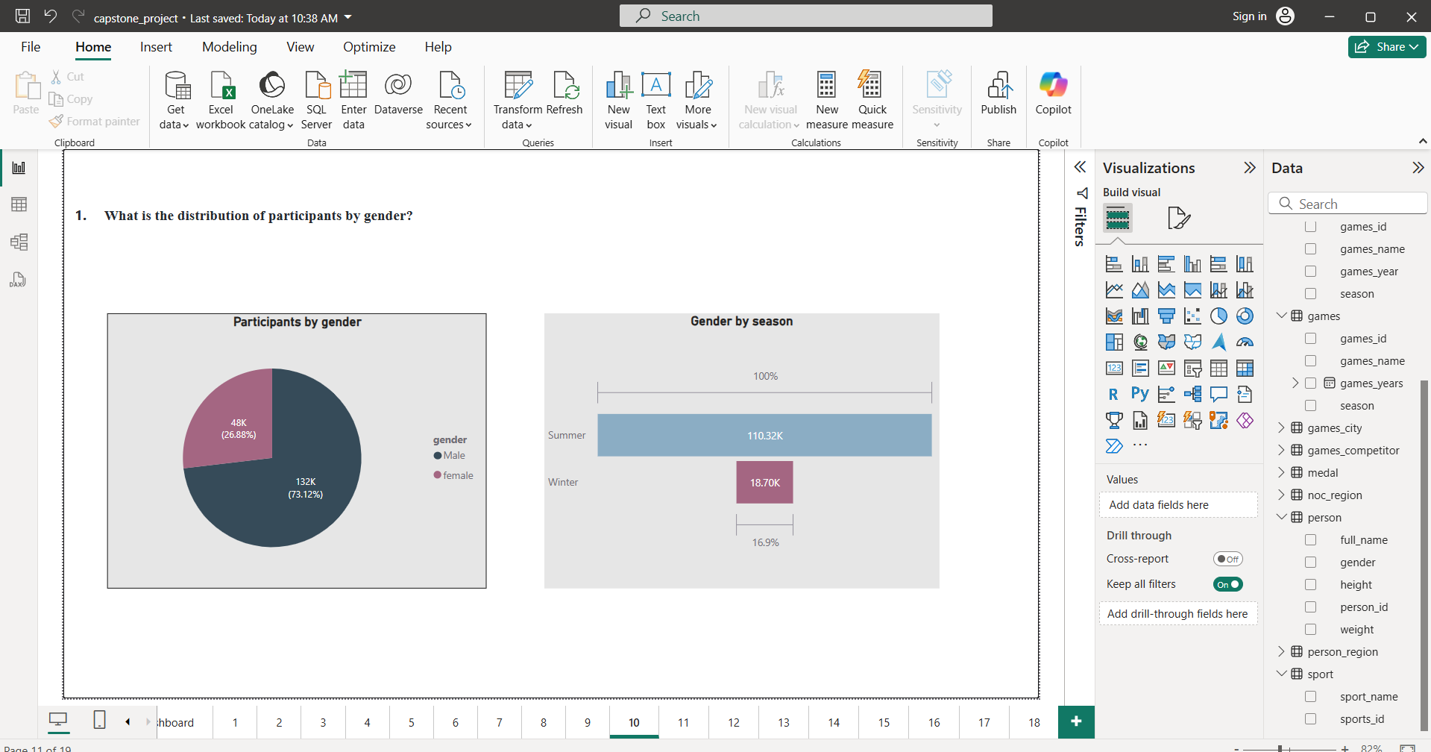
10

Slide 35
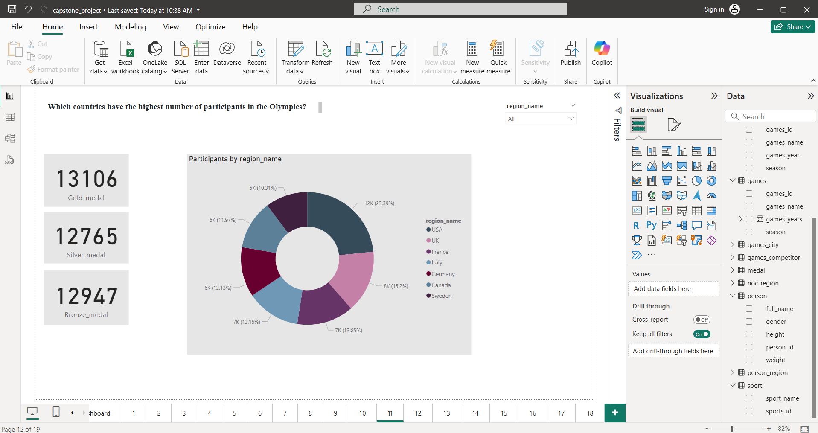
11

Slide 36
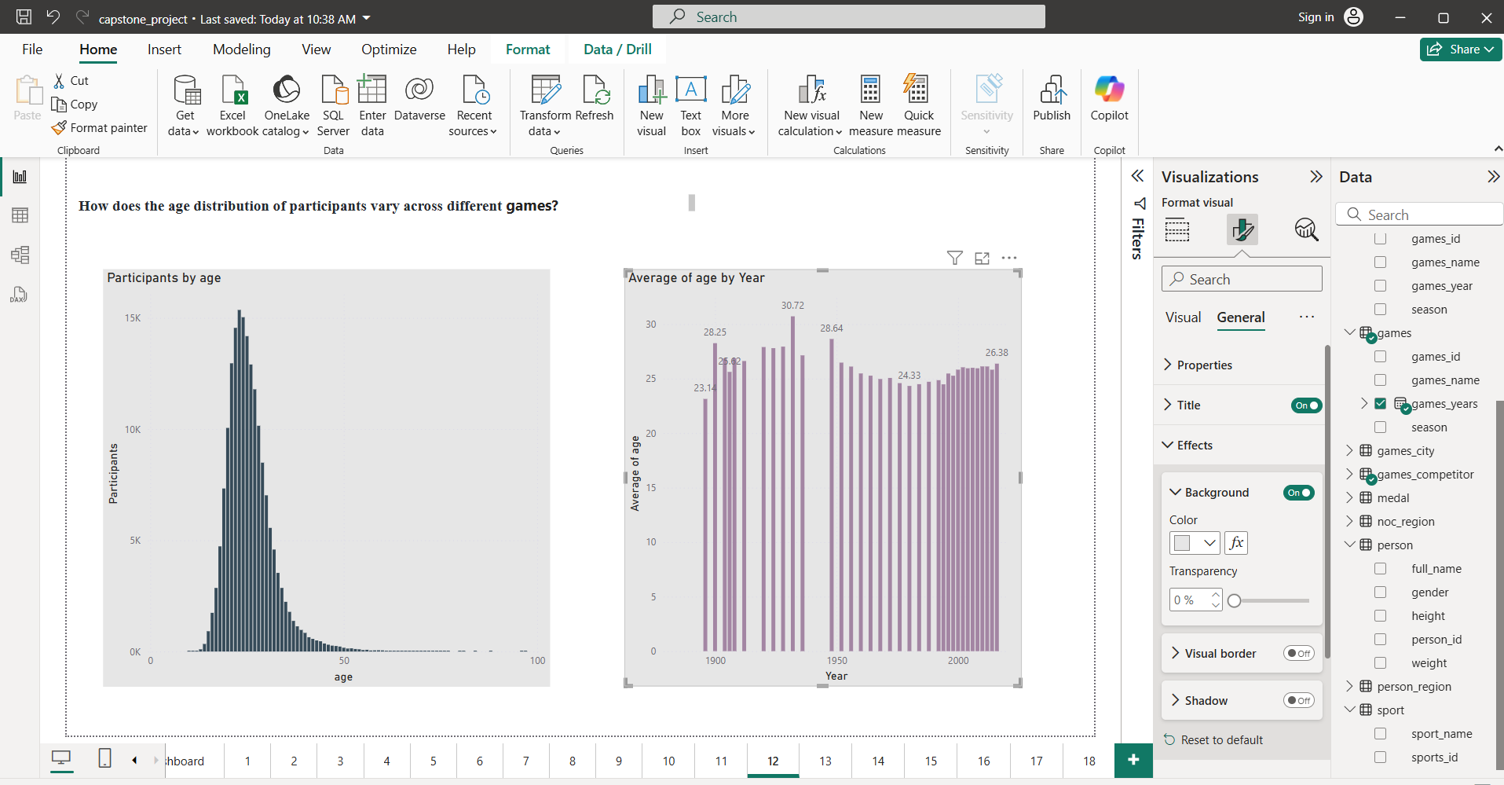
12

Slide 37
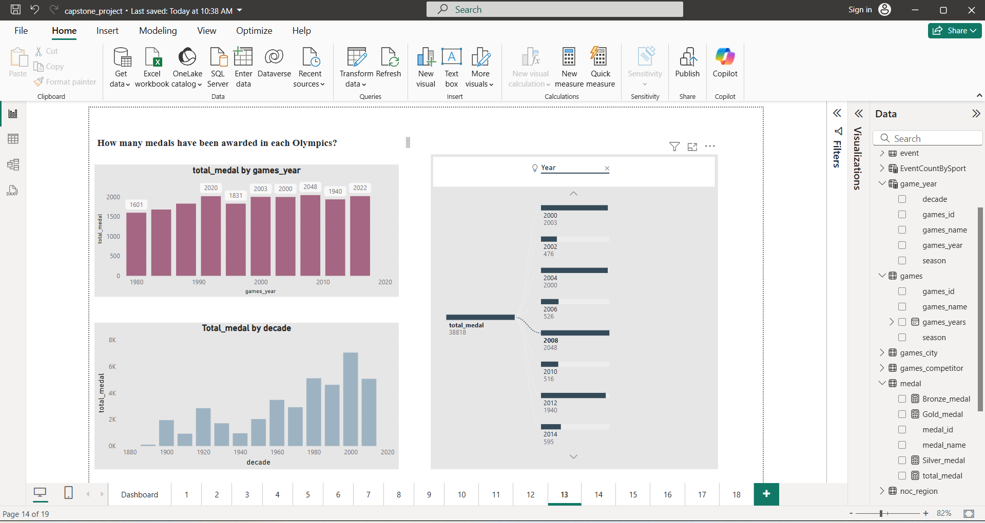
13

Slide 38
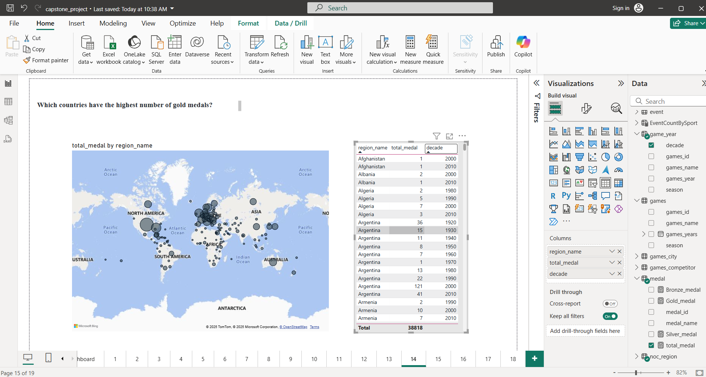
14

Slide 39
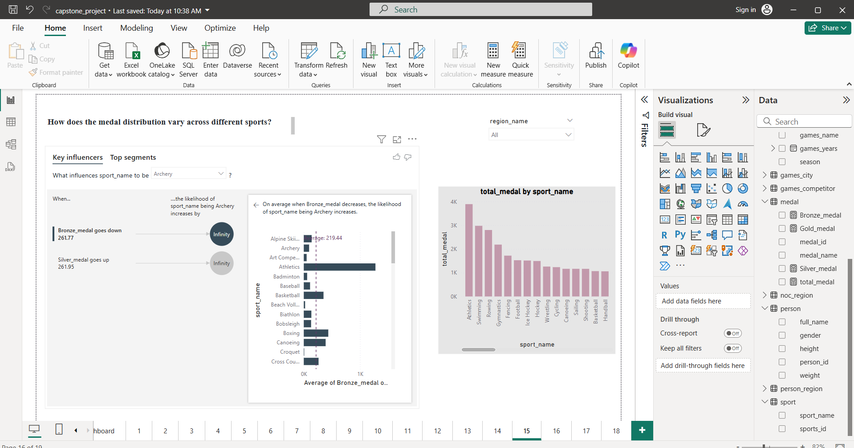
15

Slide 40
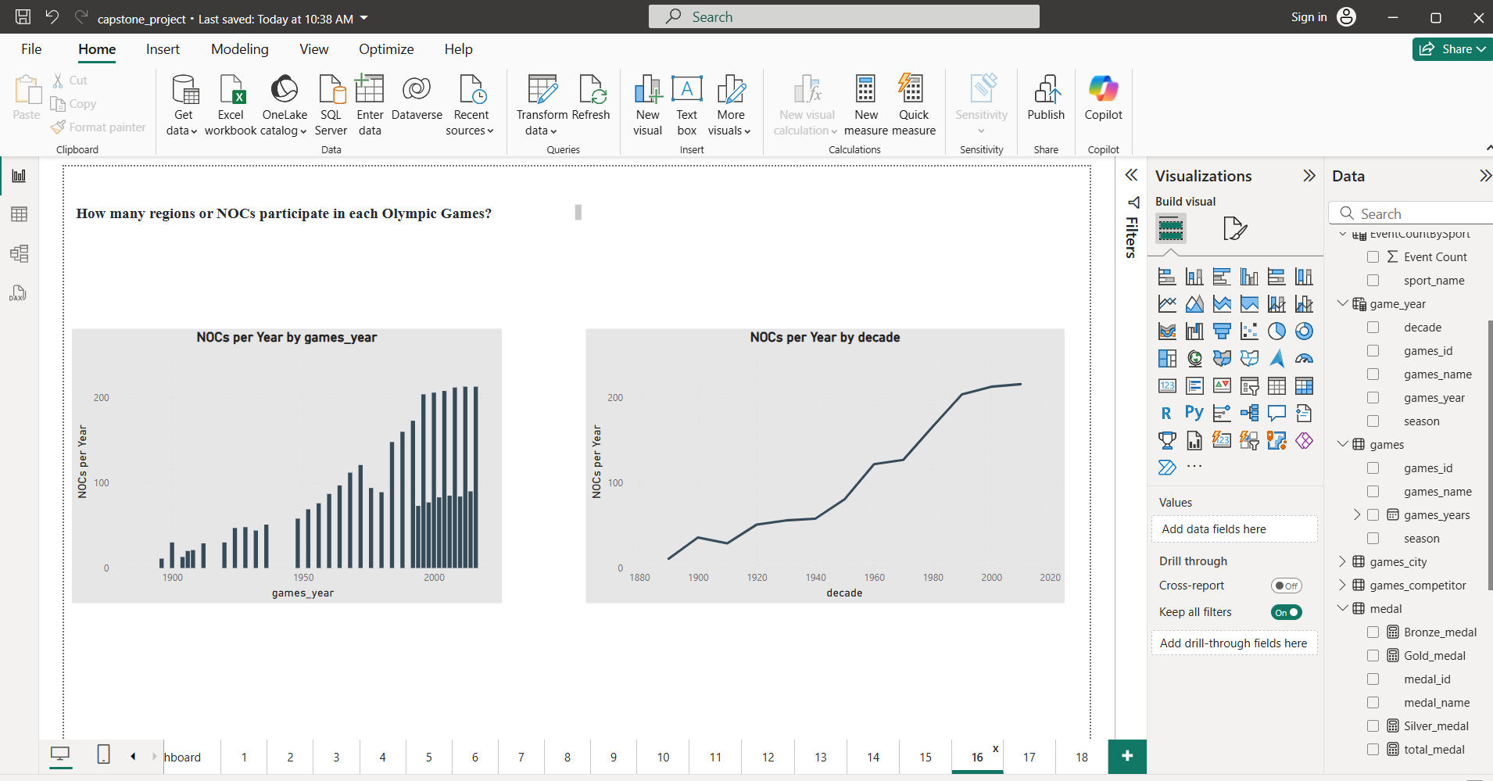
16

Slide 41
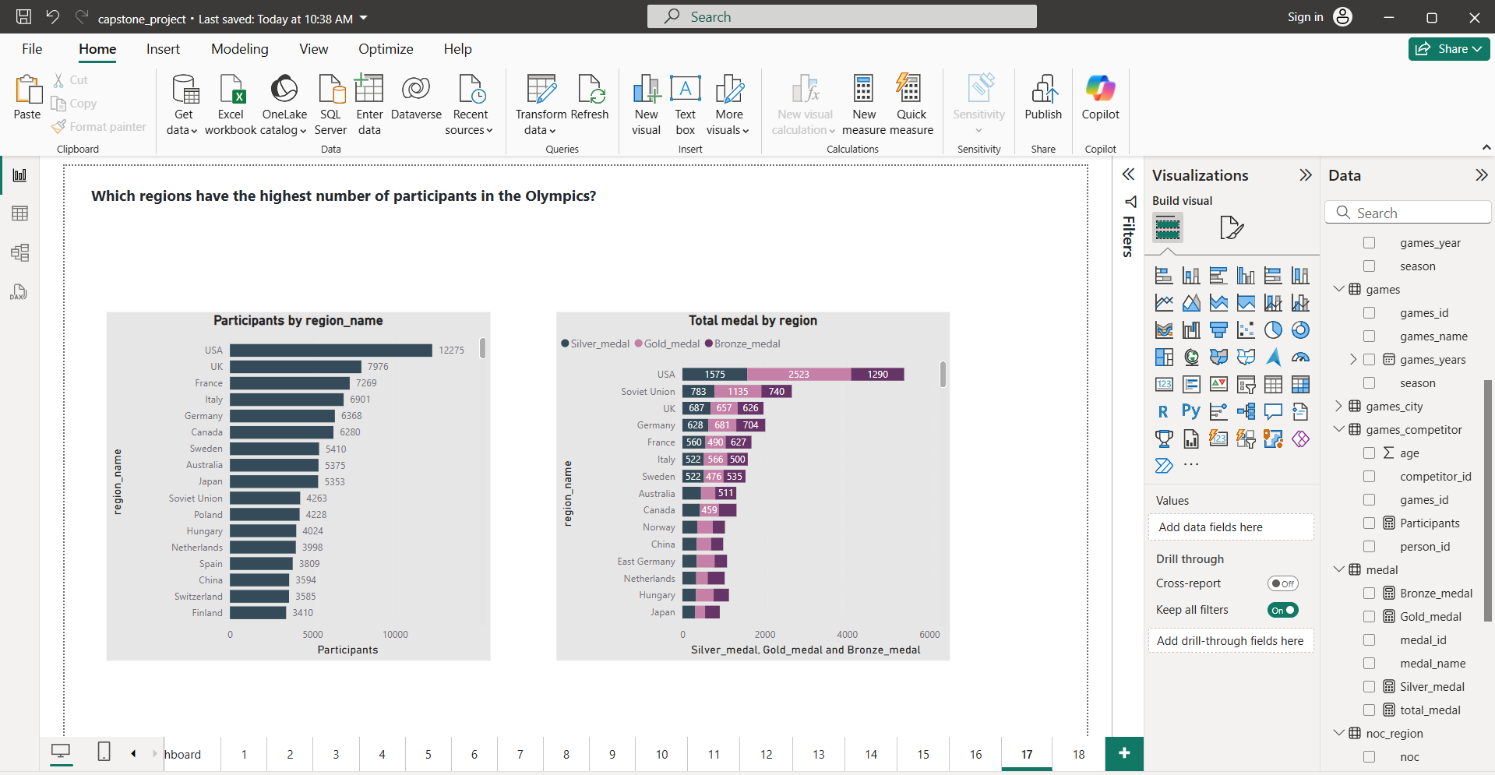
17

Slide 42
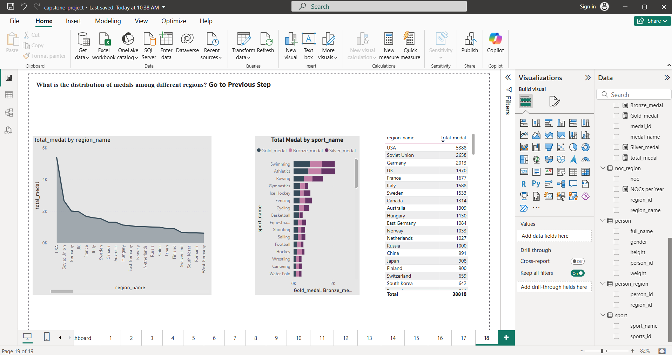
18

